Slide 1
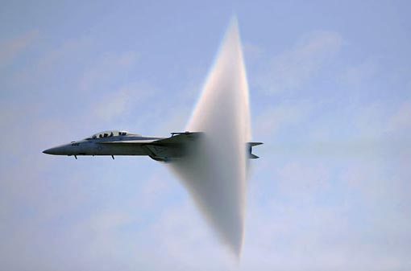
Speed of Waves
This lesson will introduce you to the characteristics of sound waves
You will also learn how to calculate the speed of sound in air

Slide 2
Learning Goals
By the end of this lesson, you will be able to:
state the universal wave equation
explain the factors that affect the speed of a wave
label and explain the sound spectrum
determine the speed of sound in air
calculate the Mach number of an object

Slide 3
Success Criteria
Can I:
state and explain the universal wave equation
state and explain the two factors that affect the speed of a wave
draw a fully labelled diagram of sound spectrum
calculate the speed of sound in air and use this to determine the Mach number

Slide 4
SOUND Waves
Sound is a longitudinal wave
It is produced when the molecules of the medium that the sound is travelling through are compressed and rarefacted.
A tuning fork produces sound waves in air when the tines move in and out.

Slide 5
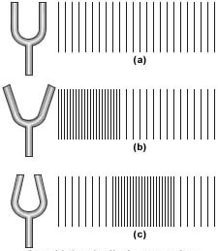

Slide 6
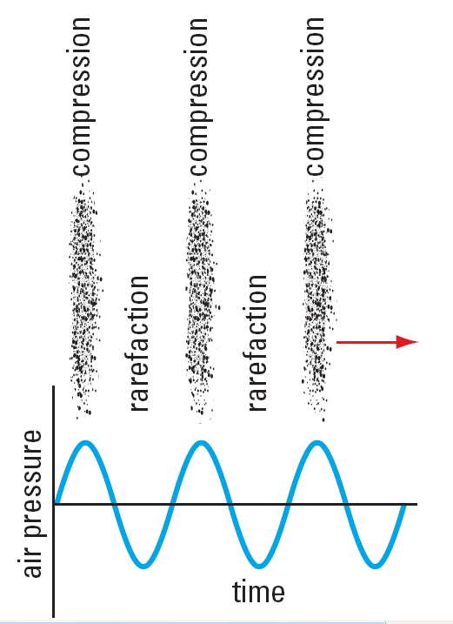
Compressions are areas of high pressure
Rarefactions are areas of low air pressure .

Slide 7
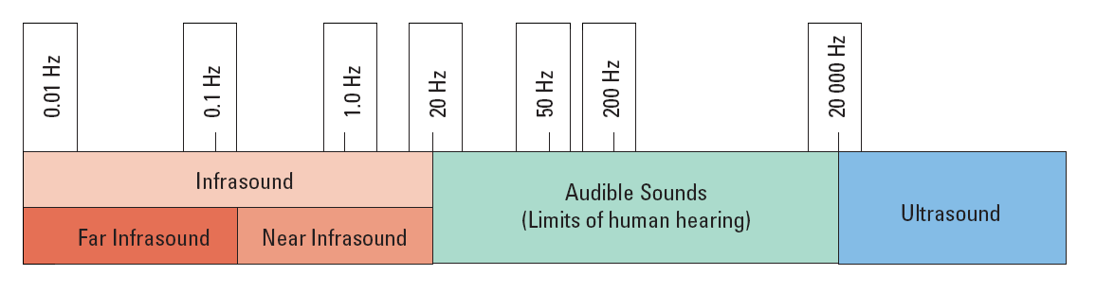
SOUND Spectrum
the average human can hear sound waves that are between 20 to 20000 Hz
sound waves below 20 Hz are called infrasonic sounds
sound waves above 20000 Hz are called ultrasonic sounds

Slide 8
Speed of Sound
the transmission of sound, (or any wave), through a medium depends on two factors:
1. the temperature of the medium
2. The density of the medium
the speed of sound in solids is much faster than in gases. This is because solids are denser than gases.

Slide 9
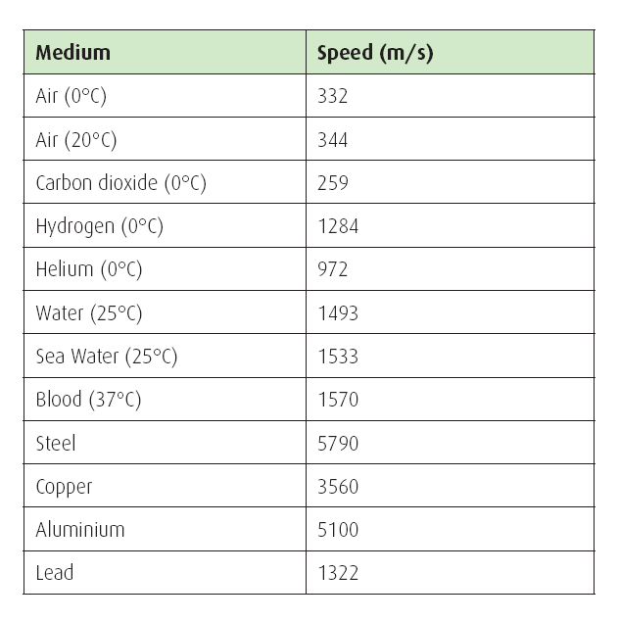

Slide 10
the speed of sound in air can be calculated using an eqn
T is temp in ºC and v_{sound} is in m/s
an application of the v_{sound} in air is measuring the
distance to a lightning strike.
Lightning and thunder are produced at the same time. But because the speed of light is so much faster than the speed of sound, we see the flash before
we hear the thunder.

Slide 11
Sample Problem
During a thunder storm, a lightning strike is observed and the thunder is heard 3.0 s later. If the air temp is 20.ºC, what is the distance to the strike?
Sol’n:
T = 20. ºC
t = 3.0 s
∴ The distance is 1.0 x 10³ m

Slide 12
Sample Problem
What is the wavelength of a 225 Hz sound wave that is produce in air at a temp of 10.ºC ?
Sol’n:
T = 10. ºC
f = 225 Hz
∴ The wavelength is 1.5 m

Slide 13
MACH Number
the Mach number is the ratio of an objects speed to the speed of sound
the Mach number tells us how many times the speed of sound an object is travelling at.

Slide 14
HOMEWORK
Read Section 8.4 – first half of 8.5
Questions 1 – 3 pg 389
1, 3, and 4 pg 391
1 – 3 pg 393
1 – 3 pg 394

